Slide 1
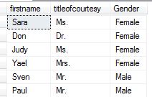
IIF
IIF computes a boolean expression and generates 2 possible results if it is true or false.
Note it is an expression – not a statement! It does not let you control the flow of activity. It just returns a value!
IIF is allowed wherever a scalar expression is allowed, for example in SELECT, WHERE, HAVING, ORDER BY, etc.
E.g.
SELECT firstname, titleofcourtesy, IIF(titleofcourtesy = 'Mr.', 'Male', 'Female') AS Gender
FROM HR.Employees
Wrong!

Slide 2
CASE Expressions
A CASE expression returns a scalar value based on conditional logic.
Note it is an expression – not a statement! It does not let you control the flow of activity. It just returns a value!
CASE is allowed wherever a scalar expression is allowed, for example in SELECT, WHERE, HAVING, ORDER BY, etc.
Simple CASE: Matches an expression against a sequence of values in WHEN clauses and returns the value after the THEN clause for the first value that matches.
If none of the cases match and an ELSE clause is present then the value in the ELSE clause is returned.
If there is no ELSE clause and none of the cases match then NULL is returned – bad programming practice!
Notes:
SQLSIMPLECASE.sql

Slide 3
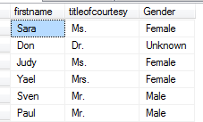
Simple CASE Expression
E.g.
SELECT firstname, titleofcourtesy,
CASE titleofcourtesy
WHEN 'Mr.' THEN 'Male'
WHEN 'Mrs.' THEN 'Female'
WHEN 'Ms.' THEN 'Female'
ELSE 'Unknown'
END AS Gender
FROM HR.Employees
Effect of ELSE
Notes:
SQLSIMPLECASE.sql

Slide 4
Searched CASE Expression
Searched CASE: Differs from the Simple CASE in that:
there is no value or scalar expression after CASE
and
predicates and logical expressions can be specified in the WHEN clause.
E.g. Simpler way of doing the previous example:
SELECT firstname, titleofcourtesy,
CASE
WHEN titleofcourtesy = 'Mr.' THEN 'Male'
WHEN titleofcourtesy IN ('Mrs.', 'Ms.') THEN 'Female'
ELSE 'Unknown'
END AS Gender
FROM HR.Employees
Notes:
SQLSearchedCase.sql

Slide 5
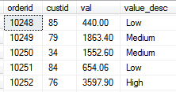
Searched CASE Expression
E.g.
SELECT orderid, custid, val,
CASE
WHEN val < 1000.00 THEN 'Low'
WHEN val BETWEEN 1000.00 AND 3000.00 THEN 'Medium'
WHEN val > 3000.00 THEN 'High'
ELSE 'Unknown'
END AS 'value_desc'
FROM Sales.OrderValues;
Notes:
SQLSearchedCase.sql

